Slide 1
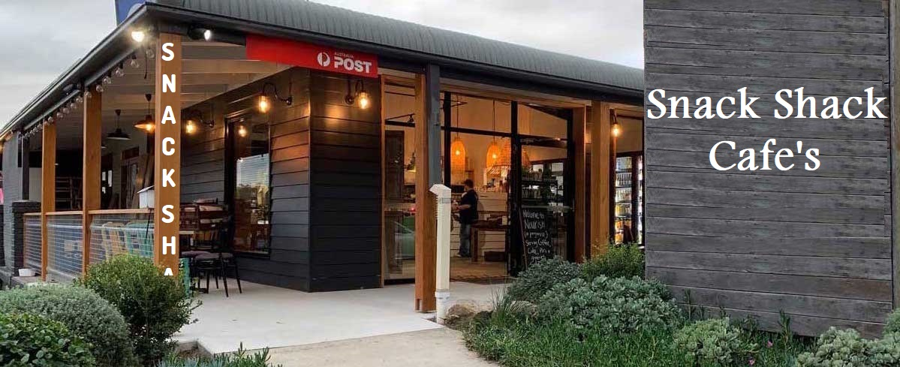
Submitted by:
Darshan (20BCS2353)
Sayan Sarkar (20BCS2299)
Atul (20BCS2271)

Slide 2

INDEX
INTRODUCTION
OBJECTIVES
TECHNOLOGY USED
DESIGNS
SCREENSHOTS
OUTCOMES

Slide 3

Introduction
The Snack Shack Cafe website help to convert traditional cafe or restaurants into web. This also helpful for providing sales report,Payment management and data management.

Slide 4
Objective:
To develop an easy to use web based interface.
Manages the meal type details online.
Manages the information of the café.
To increase efficiency of managing the canteen.
Integration of all records of meal.
To convert normal café to digital café.

Slide 5
Technology used
SOFTWARE REQUIREMENT
HARDWARE REUIREMENT
OPERATING SYSTEM:
Windows 7/ 10 / 11
LANGUAGE:
HTML
CSS
JS
PHP
BOOTSTRAP
MYSQL SERVER and PHP My Admin
Dual-core 32/64-bitprocessor.
Upto4GBofmemory.
Upto4GB of internal storage Android SDK:2GB
WindowsSDK:4GB.
Network interface card

Slide 6
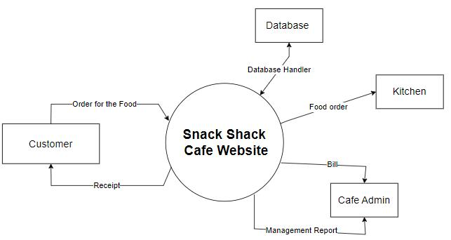
Designs (DiagrAMs DFD, ERD etc.)
Data Flow Diagrams:
Figure 1 [Level Zero DFD]

Slide 7
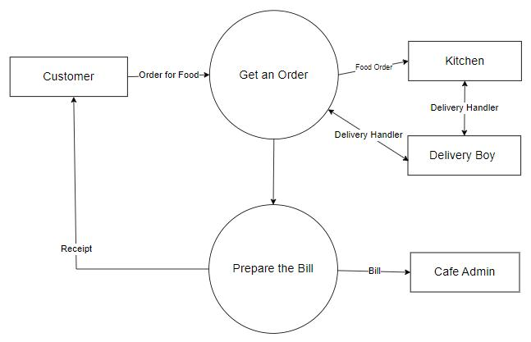
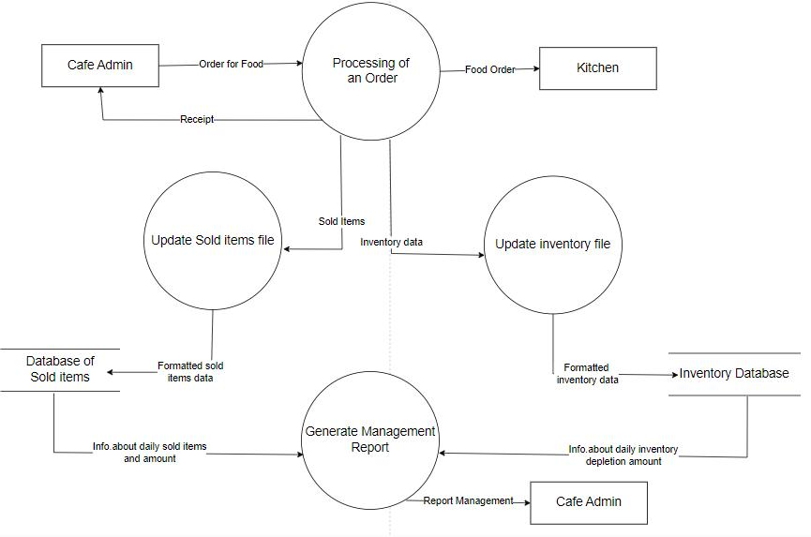
Figure 2 [Level One DFD]
Figure 2 [Level One DFD
Figure 3 [Level Two DFD]

Slide 8
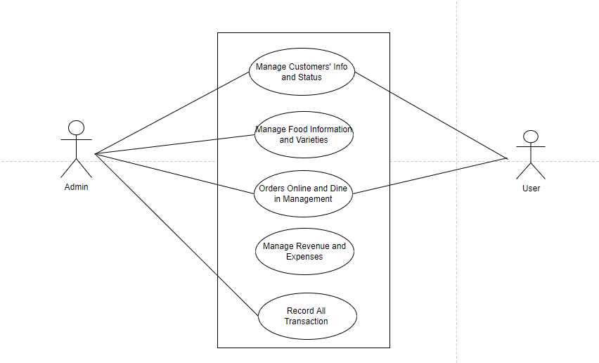
Use Case Diagram:
Figure 4[Use Case Diagram]

Slide 9
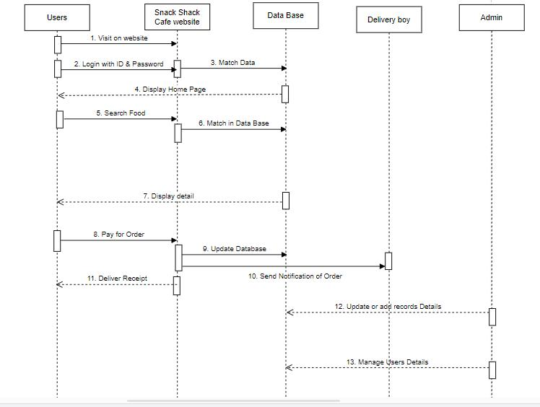
Sequence Diagram:
Figure 5 [Sequence Diagram]

Slide 10
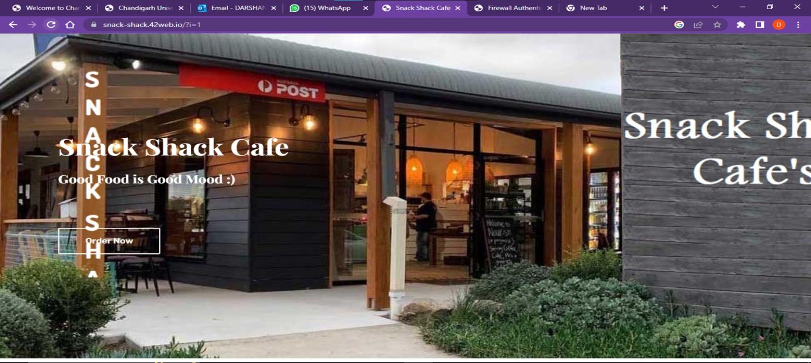
Screenshots:
User Interface of the website:

Slide 11
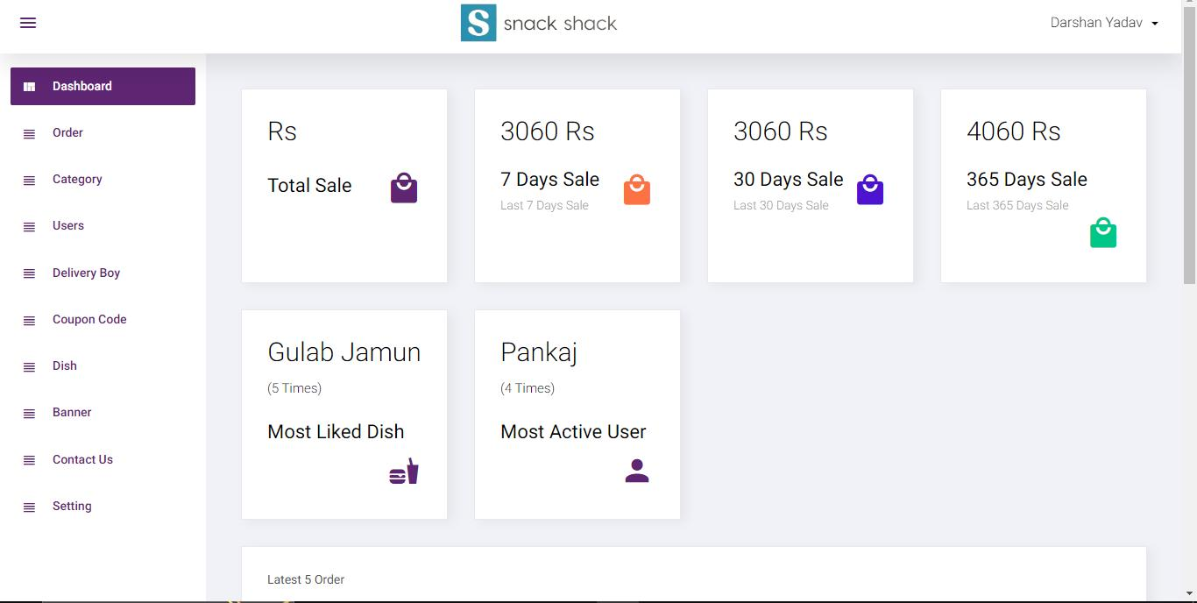
Admin Interface phage:

Slide 12
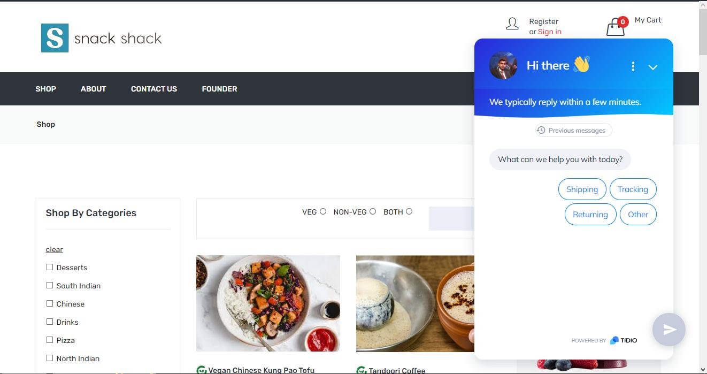
Shop Phage:

Slide 13
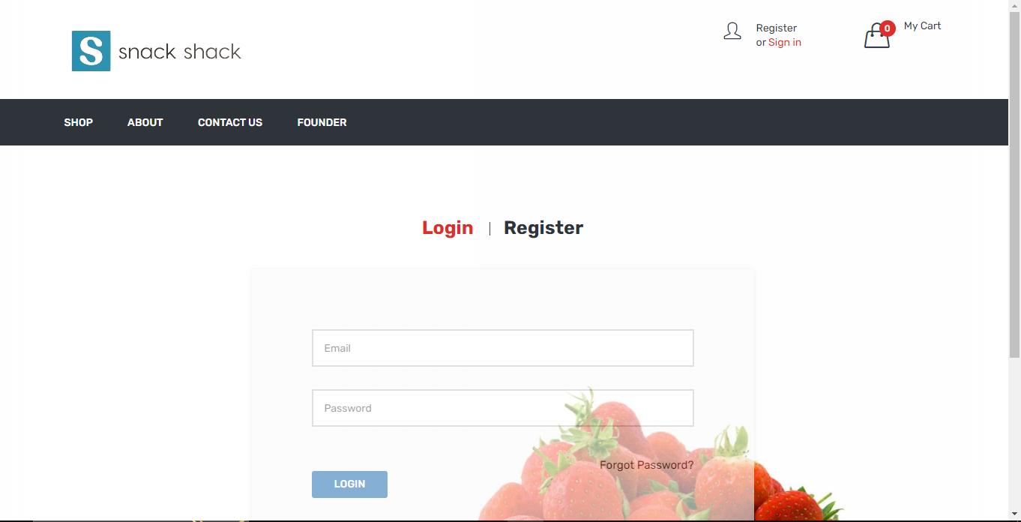
Login & Register Phage:

Slide 14
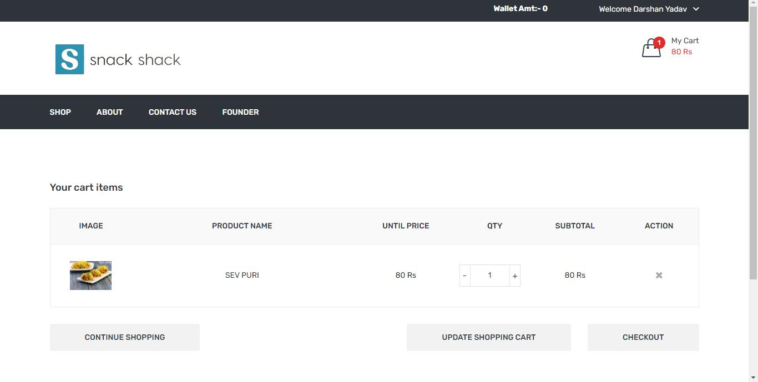
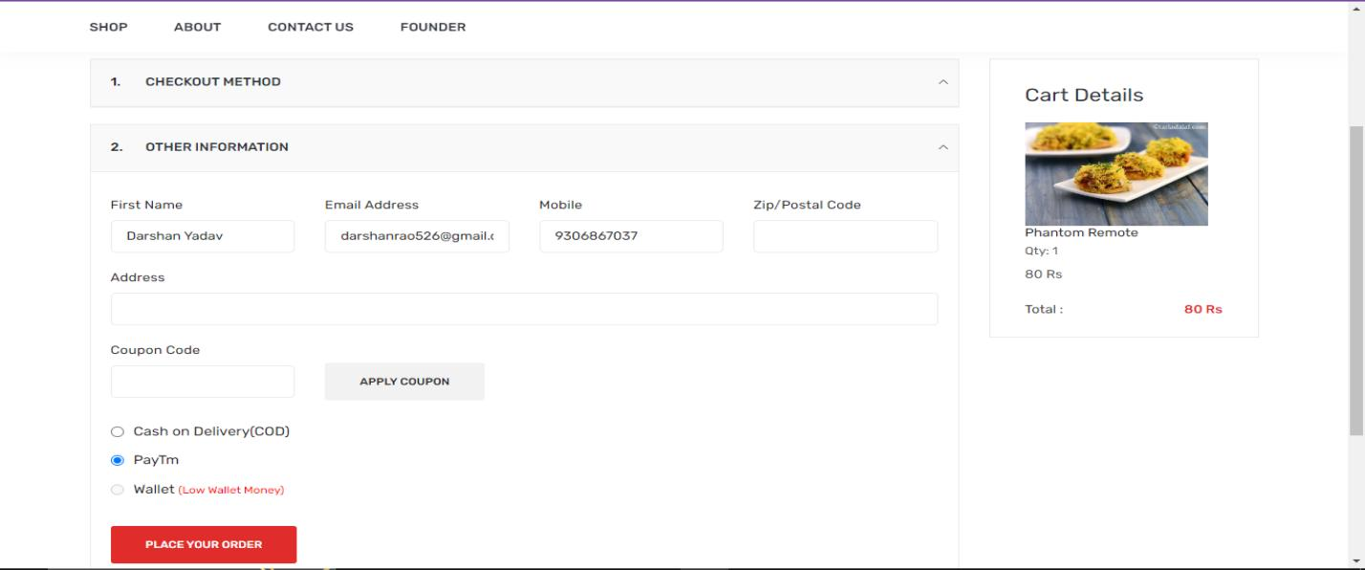
Checkout Phage:

Slide 15
Outcomes:
Improve Customer Relationships
Tracking Sales
Make digital network
Automatic Analysis
Enhanced Productivity

Slide 16

REFERENCES
Gradle.org
W3school.com
getbootstrap.com
Swiperjs.com
Youtube

Slide 17



